Slide 1
CELLULAR MOBILE COMMUNICATION
P.RAJESH M-Tech.,
Dept of ECE
CRIT ENGG college

Slide 2
Principle of cellular mobile system
Example is mobile phone n/w (cell phone)
Mobile phone is portable used to receive (or) make call through a cell site (base station) or transmitting tower
electromagnetic waves are used to transfer signal to and from the cell phone
Modern mobile phones n/w use cells because
Radio frequencies are limited.

Slide 3
A cellular n/w is used by the mobile phone operator to achive both coverage and capicty for their subscriber where large geographical areas split in to smaller cell to avoid line of sight .
All cell sites are connected to telephone exchange (or) switches, which in turn connect to public telephone.

Slide 4
Components of cellular mobile n/w
Mobile station
Base station
Mobile switching center (MSC)
Base station controller (BSC)
Public switched telephone network (PST)

Slide 5
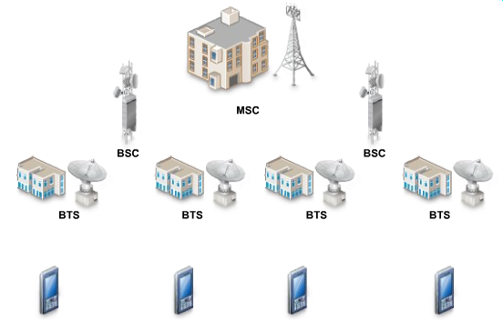
Cellular network components

Slide 6
Mobile station :-
Mobile phone contains a transceiver an antenna and control circuitry antenna converts tx RF signal in to EM waves and recived EM wave & received EM wave in to Rf signal
Base station:
provides direct communication with mobile phones and defines cell are grouped together a cluster is formed within a cluster no channel are reused .

Slide 7
Mobile stwiching centre : -
This is connected to the base station centre MSC (Mobile Switching Center) – the coordinator of a cellular network, it is connected to several BSCs, it routes calls between BSCs; links the cellular network with other networks like PSTN through fiber optics, microwave or copper cable

Slide 8
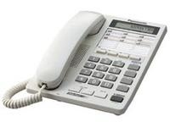

MS, BS, BSC, MSC, and PSTN
Home phone
PSTN
MSC
…
MSC
BSC
…
BSC
BSC
…
BSC
…
…
…
…
BS
MS
BS
MS
BS
MS
BS
MS
BS
MS
BS
MS
BS
MS
BS
MS

Slide 9
Coverage area of cells:
In cities each cell site may have a range of ½ mile ,
In rural areas the range could be much as 5 mile.
In clear open area user may recive signal from 25 miles

Slide 10
Why cellular mobile telephone system
1. Limitations of convectional mobile tele phone systems:
Limited services capability
Poor services performance
In efficient frequency spectrum utilization

Slide 11
Limited services capability
Designed for selecting 1 or more channels from a specific frequency allocation for use of geographic zones.
In a coverage area of each zone has to be planned to be as large as possible
i.e the transmitted power should be as high as federal specifications allows

Slide 12
Poor services performance
In past a total 33 channels are alloted to 3 mobile telephones systems.
Mobile telephone services (MTS)
Improved mobile telephone services (IMTS) MJ systems
Improved mobile telephone services (IMTS) MK systems

Slide 13
MTS operates at 40 MHZ
MJ operates at 150 MHZ
IMTS Operates at 450MHZ provides 12-channels
These 33-channels covers around 50 miles in diameter
Each provide
11-channels

Slide 14
In efficient frequency spectrum utilization
In convectional mobile telephone system frequency utilization measurement M0 is defined as maximum no:- of customers that could be served by one channel at busy hour
M0 = no:- of customers / channels
or
M0 = 53 customers / channel (MJ systems)
37 customers / channel (Mk systems)

Slide 15
2. Spectrum efficiency considerations
Major problem facing the radio communication industry is limitation of available radio frequency spectrum
In setting allocation policy system which need
Minimal bandwidth but provide high usage and consumer satisfaction
The ideal mobile telephone system would operate within a limited assigned frequency band and would serve an almost unlimited no:- of users in unlimited area

Slide 16
The major approach to achieve ideal are
Single side band(SSB):-
which divides the allocated frequency band in to maximum no of channels
Cellular which reuses the allocated frequency band in different geographical locations
Spread spectrum (or) frequency –hopped which generate many codes over a wide frequency band.

Slide 17
2.Why 800 mhz ?
Federal communication commission (FCC) decision to choose 800 mhz was made because of serve spectrum limitations at lower frequency bands .
A) FM – broadcasting operates at (100 Mhz)
B) TV – broadcasting services starts (41mhz-960 mhz)
C) air to ground systems—uses (118 -136 mhz)
D) military air crafts use (225-400 mhz)
E ) maritime mobile services allocated at (160 mhz)
G) fixed station services is allocated portions (30-100 mhz)

Slide 18
To allocate spectrum for FCC in a lower portion (30-400 mhz) was very hard bcoz band had become so crowed.
Where 800 mhz originally assigned for educational and tv channel.
FCC allocated 40 mhz system at 800mhz for mobile radio cellular systems

Slide 19
3.History of 800MHZ spectrum allocation
In 1958 Bell system proposed a 75MHZ system at 800 mhz quiet broad band proposal
In 1970 FCC decided to allocate 75MHz for wire line common carrier
In 1974 the FCC allocated to 40Mhz of spectrum which one cellular system to be licensed per market
In 1980 FCC reconsidered its one system per market strategy .

Slide 20
The frequencies will be assigned in 20Mhz groups identified as block ‘A’ and Block ‘B’ (or) called band ‘A’ and band ‘B’.
2-bands serve to two different groups in standard sitituation.
One for wire line companies and other for non-wire line(telephone) companies.

Slide 21
Band | mobile | base | two systems/market
A | 824-835, 845-546.5 | 869-880 890-891.5 | Non wire line
B | 835-845 846.5-849 | 880-890 891.5-894 | Wire line

Slide 22
Each company designs its own system and divides the area (or) cells . Each cell operates with in its own bands.
30KHz is specified BW, each band operates nowadays consists 333 channels.

Slide 23
4. Trunking efficiency
In tele-commu , truncking is a method for a system provides a network access to many clients by sharing a set of lines (or) frequencies instead of providing individually.
it is a analogues to the structure of tree with one trunk and many branches.
Eg: port trucking has been applied in computer networking
As trunk is a single transmission channel between two points each point being either the switching center (or) node.

Slide 24


Eg:
Find a trunking efficiency between one cellular system per market 666 channels and two cellular system per market 333 channels as avg call time is 1.76min and blocking probability is B=0.02 ?
Soultion:- let assume frequency evenly divided into 7 cells
& B= 0.02 i.e Offered load A1= 83.1
& B= 0.02 i.e Offered load A2= 38

Slide 25



i.e total offered load is A1>2A2
The no: of call per hour in cell is

Slide 26
Trunking efficiency degradation factor is
ȵ = (2832.95-259.9) / 2832.95 = 8.5 %
For blocking probability 2%

Slide 27
5. Performance criteria
There are 3 categories
1. voice quality
2. service quality
3. special features

Slide 28
1.voice quality:-
voice quality is very hard to judge without subjective test from user opinion.
In technical area engineer cannot decide how to build a system with out knowing the voice quality.

Slide 29
Circuit Merits | SOURCE | QUALITY SCALE
CM5 | 5 | Excellent (speech perfectly undersatble)
CM4 | 4 | Good (speech understable some noise)
CM3 | 3 | Fair (speech understandable only with slight effort)
CM2 | 2 | Poor (frequently reception needed)
CM1 | 1 | Un satisfied (speech not good)

Slide 30
2. Service quality
1. coverage :-
System should serve an area as large as possible with radio coverage because of irregular terrain configuration usually not possible to over 100% of area for 2- reasons .
A) transmitted power would have to be very high to illuminate weak spots with sufficient reception
B) the high the transmitted power the harder it becomes to control interface.
2. Required grade of service :-
For normal start up of system grade of service (GOS) specified for blocking probability of 0.02 for intiating calls at busy hour.

Slide 31
3. number of dropped calls :-
During Q-calls in an hour if call is dropped and Q-1 calls are completed then call drop rate is 1/Q.
4. Special features :-
System would like to provide many features like call forwarding, call waiting , voice stored box(VSR), automatic roaming (or) navigation services.

Slide 32
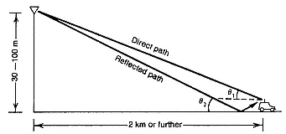
6.Uniqueness of Mobile Radio Environment
Mobile radio transmission model.

Slide 33

The Propagation Attenuation:
The propagation path loss increases not only with frequency but also with distance
•The propagation path loss would be 40 dB/dec
•This means that a 40‐dB loss at a signal receiver will be observed by the mobile unit as it moves from 1 to 10 km.
R⁴ = distance between Rx & Tx
C = recived carrier power

Slide 34


The difference in power reception at two different distances R1and R2will result in
Difference expression in power reception is

Slide 35
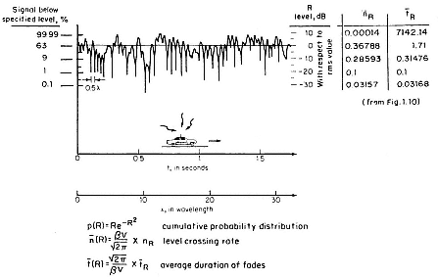
Atypicalfadingsignalreceivedwhilethemobileunitismoving (Severe Fading)

Slide 36
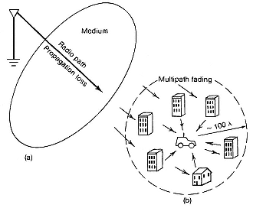
Mobile Fading Characteristics

Slide 37
Mobile fading characteristics
Rayleigh fading is also called fading in mobile radio environment .
When multipath fading wave bounce back and forth due to building and houses they form many standing wave pairs in space .
The standing wave pairs are summed together and become an irregular wave fading structure .
When a mobile unit is standing still its receiver only receiver a signal strength at that spot so constant signal is observed when mobile unit is moving the fading structure of wave in space is received it is multipath fading.

Slide 38
Delay spread and coherence bandwidth:
Coherence BW is defined in which either amplitudes (or) phases of 2-recived signal have a high degree of similarity.
A coherence bw of 2-fading amplitudes of two recived signal is
Bc = 1/ 2ПΔ
Δ= delay spread
Bc = coherence band width

Slide 39
Delay spread:-
in mobile radio enviroment as result of multipath reflection phenomenon the signal transmitted at cell site reach the mobile unit takes different paths.
radio signal takes 2-paths.
a) Direct path:- signal from mobile unit is called direct path
b)In direct path:- signal from cell site to surface and surface to mobile unit is indirect path .
These angles are reflection (or) elevation

Slide 40
Type of environment | Delay spread Δ(usec)
Open area | <0.2
Urban area | 3
Sub urban | 0.5
Inside the building | <0.1

Slide 41
Operation of cellular system
Explains about operation of cellular mobile system from a coustumer’s The operation is divided in to 4-parts
A) mobile unit intialization :-
When mobile unit is turned on it scans and selects the strongest setup control channel used for system Cells with different frequency bands repetitvely Boardcast on different setup channel
The receiver selects the strongest setup channel
And monitors that channel With this mobile station has automatically selected The bs antenna of the cell within which it will operate

Slide 42
The hand shake takes place b/w the mobile unit
And MTSO controlling this cell through the BS in this cell
Hand shake is used to identity the user and register its location
As long as the mobile station is on scanning is repeated periodically to account for the motion of unit repeated periodically to account for the motion of unit
If the unit enters a new cells then a new BS is selected

Slide 43
Mobile originated cell
A mobile unit originates a call by sending the no (mobile indentification no:-(MIN) of the called unit on the preselected setup channel the receiver of mobile unit chects if the forward chanel (from bs ) is idel If idel the mobile may transmit over the reverse channel (To BS )
BS sends request to the MTSO
Pageing :-
MTSO setup attempts to complete connection depending on called mobile no
BS sends pageing signal on its own assigned setup channel

Slide 44
Call accepted :-
Called mobile unit recognizes its number on the setup channel being monitored and responds to that BS which sends the response to the MTSO
MTSO up a circuit between
Calling and called BS’s
MTSO selects available traffic channel within each BS’s cell and notifies each BS which in each turn notifies its mobile unit called alret is transmitted over fvc to instruct the mobile ring
The tow mobile unite tune to their respective channels

Slide 45
Ongoing Call:-
While connection is maintained two mobile stations exchange voice (or) data trough BS’s and MTSO.
Hand Off:- if a mobile unit movies from range of one cell to anothr the traffic channel has to change.
system makes their changes without either interrupting the call (or) alterting the users.
Call blocking :-
If all traffic channels are busy even after multiple attempts a busy tone is returned.
Call termination :
when one user hang up MTSO is informed and the traffic channels are released.
CALL drop:- during a connection because of interface (or )weak signal speaks the BS count maintains the minimum required signal strength for certain period of time the traffic channel is dropeed and MTSO is informed.

Slide 46
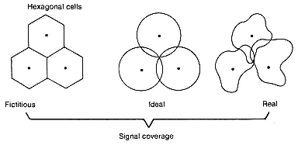
Marketing Image of Hexagonal‐shaped Cells

Slide 47
Planning of cellular system
Is very crucial in design of cellular system.
1. regulation
2.market situations
1. regulations :- the federal regulation controlled by federal commission (FCC) are similar in every part of united states the regulations may vary from state to state and with in the state each city and town have their own building codes and zoning laws.

Slide 48
2. Market situations :
i) prediction of gross income : in this task we have to find out the population of market area (in which we are constructing the cellular the cellular systems ) we also need to find out the average income business type. Which utilize to predict in gross income.
ii) understanding compactors :
We must have a knowledge of competitors coverage area systems performance and the no: of users the competitor is serving. To over come we must design a system that provides unique and magnificent services.

Slide 49
Iii) decision of geographic coverage :-
In this task we need to answer the following questions before passing the decision on to engineering dept
A) what general area should ultimately be covered
B) what near term service can be provided in a limited area.

